Slide 1
DATABASE MANAGEMENT SYSTEM
By:
KEERTHANA.A

Slide 2
WHAT IS DATABASE?
Database is a collection of related data and data is a collection of facts and figures that can be processed to produce information.
A database management system stores data in such a way that it becomes easier to retrieve, manipulate, and produce information.

Slide 3
Characteristics
Real-world entity
Relation-based tables
Isolation of data and application
Less redundancy
Consistency
Query Language
ACID Properties − DBMS follows the concepts of Atomicity, Consistency, Isolation, and Durability.
Multiuser and Concurrent Access
Multiple views
Security

Slide 4
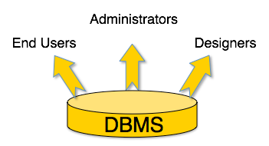
Users
A typical DBMS has users with different rights and permissions who use it for different purposes. Some users retrieve data and some back it up.

Slide 5
Entity-Relationship Model
Entity-Relationship (ER) Model is based on the notion of real-world entities and relationships among them. While formulating real-world scenario into the database model, the ER Model creates entity set, relationship set, general attributes and constraints.
ER Model is best used for the conceptual design of a database.
ER Model is based on −
Entities and their attributes.
Relationships among entities.

Slide 6
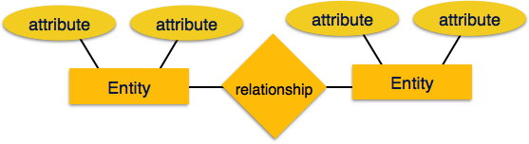
These concepts are explained below.
Entity − An entity in an ER Model is a real-world entity having properties called attributes. Every attribute is defined by its set of values called domain. For example, in a school database, a student is considered as an entity. Student has various attributes like name, age, class, etc.
Relationship − The logical association among entities is called relationship. Relationships are mapped with entities in various ways. Mapping cardinalities define the number of association between two entities.

Slide 7
Mapping cardinalities −
one to one
one to many
many to one
many to many

Slide 8
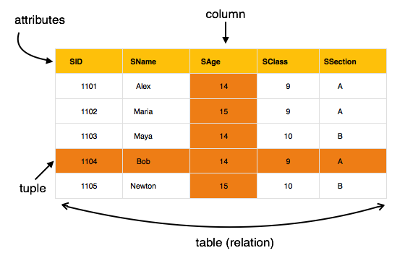
Relational Model
The most popular data model in DBMS is the Relational Model. It is more scientific a model than others. This model is based on first-order predicate logic and defines a table as an n-ary relation.

Slide 9
The main highlights of this model are −
Data is stored in tables called relations.
Relations can be normalized.
In normalized relations, values saved are atomic values.
Each row in a relation contains a unique value.
Each column in a relation contains values from a same domain.

Slide 10
Types of Attributes
Simple attribute
Composite attribute
Derived attribute
Single-value attribute
Multi-value attribute

Slide 11
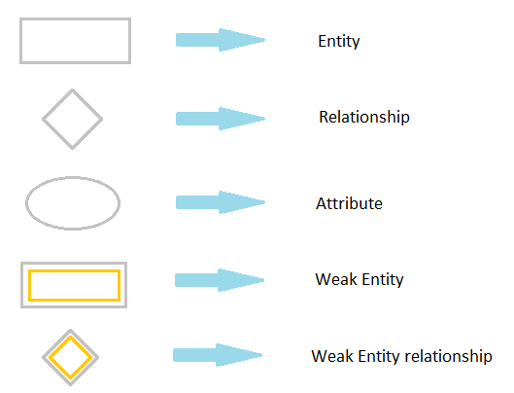
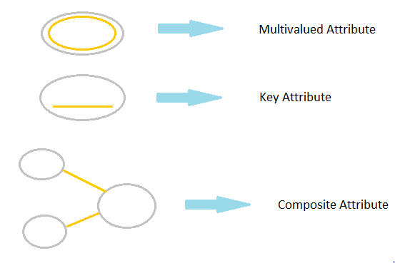
Symbols and Notations

Slide 12
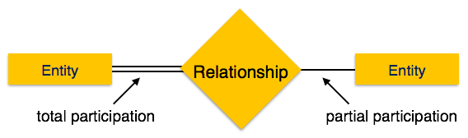
Participation Constraints
Total Participation − Each entity is involved in the relationship. Total participation is represented by double lines.
Partial participation − Not all entities are involved in the relationship. Partial participation is represented by single lines.

Slide 13
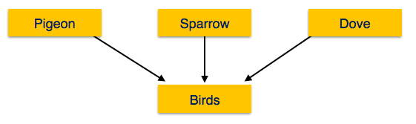
Generalization
As mentioned above, the process of generalizing entities, where the generalized entities contain the properties of all the generalized entities, is called generalization. In generalization, a number of entities are brought together into one generalized entity based on their similar characteristics. For example, pigeon, house sparrow, crow and dove can all be generalized as Birds.

Slide 14
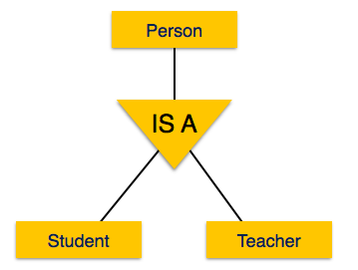
Specialization
Specialization is the opposite of generalization. In specialization, a group of entities is divided into sub-groups based on their characteristics. Take a group ‘Person’ for example. A person has name, date of birth, gender, etc. These properties are common in all persons, human beings. But in a company, persons can be identified as employee, employer, customer, or vendor, based on what role they play in the company.

Slide 15
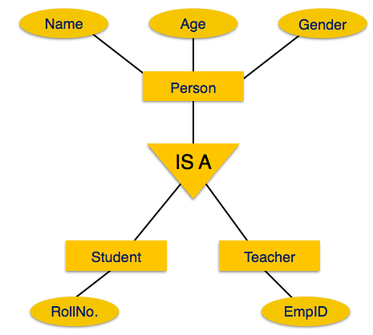
Inheritance
We use all the above features of ER-Model in order to create classes of objects in object-oriented programming. The details of entities are generally hidden from the user; this process known as abstraction.
Inheritance is an important feature of Generalization and Specialization. It allows lower-level entities to inherit the attributes of higher-level entities.

Slide 16
Entity-Set and Keys
Primary Key – A primary is a column or set of columns in a table that uniquely identifies tuples (rows) in that table.
Super Key – A super key is a set of one of more columns (attributes) to uniquely identify rows in a table.
Candidate Key – A super key with no redundant attribute is known as candidate key
Alternate Key – Out of all candidate keys, only one gets selected as primary key, remaining keys are known as alternate or secondary keys.
Composite Key – A key that consists of more than one attribute to uniquely identify rows (also known as records & tuples) in a table is called composite key.
Foreign Key – Foreign keys are the columns of a table that points to the primary key of another table. They act as a cross-reference between tables.

Slide 17
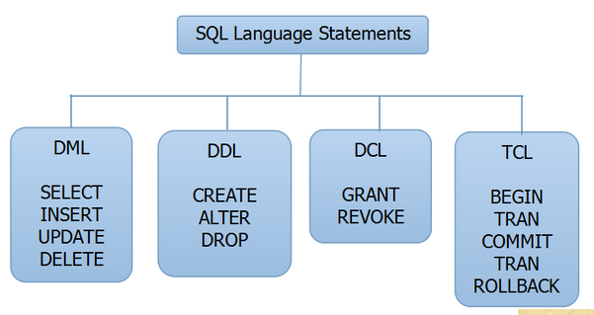
SQL
The language which is used to access DBMS is SQL (Structured Query Language)
The four main categories of SQL statements are as follows:
1. DML (Data Manipulation Language) 2. DDL (Data Definition Language) 3. DCL (Data Control Language) 4. TCL (Transaction Control Language)

Slide 18
DML (Data Manipulation Language)
DML statements affect records in a table. These are basic operations we perform on data such as selecting a few records from a table, inserting new records, deleting unnecessary records, and updating/modifying existing records.
DML statements include the following:
SELECT – select records from a table
INSERT – insert new records
UPDATE – update/Modify existing records
DELETE – delete existing records
DDL (Data Definition Language)
DDL statements are used to alter/modify a database or table structure and schema. These statements handle the design and storage of database objects.
CREATE – create a new Table, database, schema
ALTER – alter existing table, column description
DROP – delete existing objects from database

Slide 19
DCL (Data Control Language)
DCL statements control the level of access that users have on database objects.
GRANT – allows users to read/write on certain database objects
REVOKE – keeps users from read/write permission on database objects
TCL (Transaction Control Language)
TCL statements allow you to control and manage transactions to maintain the integrity of data within SQL statements.
BEGIN Transaction – opens a transaction
COMMIT Transaction – commits a transaction
ROLLBACK Transaction – ROLLBACK a transaction in case of any error

Slide 20
Basic syntax
SQL SELECT Statement:
SELECT column1, column2....columnN FROM table_name;
SQL DISTINCT Clause:
SELECT DISTINCT column1, column2....columnN FROM table_name;
SQL WHERE Clause:
SELECT column1, column2....columnN FROM table_name WHERE CONDITION;
SQL AND/OR Clause:
SELECT column1, column2....columnN FROM table_name WHERE CONDITION-1 {AND|OR} CONDITION-2;
SQL IN Clause:
SELECT column1, column2....columnN FROM table_name WHERE column_name IN (val-1, val-2,...val-N);
SQL BETWEEN Clause:
SELECT column1, column2....columnN FROM table_name WHERE column_name BETWEEN val-1 AND val-2;
SQL LIKE Clause:
SELECT column1, column2....columnN FROM table_name WHERE column_name LIKE { PATTERN };

Slide 21
Basic syntax
SQL ORDER BY Clause:
SELECT column1, column2....columnN FROM table_name WHERE CONDITION ORDER BY column_name {ASC|DESC};
SQL GROUP BY Clause:
SELECT SUM(column_name) FROM table_name WHERE CONDITION GROUP BY column_name;
SQL COUNT Clause:
SELECT COUNT(column_name) FROM table_name WHERE CONDITION;
SQL HAVING Clause:
SELECT SUM(column_name) FROM table_name WHERE CONDITION GROUP BY column_name HAVING (arithematic function condition);
SQL CREATE TABLE Statement:
CREATE TABLE table_name( column1 datatype, column2 datatype, column3 datatype, ..... columnN datatype, PRIMARY KEY( one or more columns ) );
SQL DROP TABLE Statement:
DROP TABLE table_name;
SQL CREATE INDEX Statement :
CREATE UNIQUE INDEX index_name ON table_name ( column1, column2,...columnN);

Slide 22
Basic syntax
SQL DROP INDEX Statement :
ALTER TABLE table_name DROP INDEX index_name;
SQL DESC Statement :
DESC table_name;
SQL TRUNCATE TABLE Statement:
TRUNCATE TABLE table_name;
SQL ALTER TABLE Statement:
ALTER TABLE table_name {ADD|DROP|MODIFY} column_name {data_ype};
SQL ALTER TABLE Statement (Rename) :
ALTER TABLE table_name RENAME TO new_table_name;
SQL INSERT INTO Statement:
INSERT INTO table_name( column1, column2....columnN) VALUES ( value1, value2....valueN);
SQL UPDATE Statement:
UPDATE table_name SET column1 = value1, column2 = value2....columnN=valueN [ WHERE CONDITION ];

Slide 23
Basic syntax
SQL DELETE Statement:
DELETE FROM table_name WHERE {CONDITION};
SQL CREATE DATABASE Statement:
CREATE DATABASE database_name;
SQL DROP DATABASE Statement:
DROP DATABASE database_name;
SQL USE Statement:
USE database_name;
SQL COMMIT Statement:
COMMIT;
SQL ROLLBACK Statement:
ROLLBACK;

